Slide 1

Smart Pit Hole Detection Using IOT
Seminar on
Submitted By
Nishi Mandhana(22)
Archana Sahu(25)
Shambhu Ajwani(78)
Shrikant Rathi(82)
Shubham Reddy(83)
Under the guidance of:
Prof. D.R.Naidu
Shri Ramdeobaba College of Engineering & Management, Nagpur
(An Autonomous College under RTM Nagpur University)

Slide 2
Outline
Problem Definition
Aim & Objectives
Motivation
Hardware & Software Requirements
Modules
Working
Implementation
Test case and working time
Research Papers and References

Slide 3
Aims & Objectives
To understand the basic need of the project and to alert the vehicle drivers that there is a pothole on the road.
To reduce the number of accidents caused due to pothole.
To thereby alert the user that to change the direction.

Slide 4
Problem Definition
To design a device for an application using IOT that will detect a pothole on the road.
It will indicate pit by sending alert in the form of colored marks o map on mobile or PC to alert the user.

Slide 5
Motivation
We are going to develop a effective road surface monitoring system for automated pothole detection.
This is a low cost solution for the road safety purpose.
This will help to avoid accidents and can use to identify problem areas early.
The authorities can be alerted to take preventive actions; preventive actions can save
Money
Notification to Users.
Updating a per the latest road condition

Slide 6
Requirements & Resources
Arduino:- A board used for reading inputs that uses IOT and programs the hardware.
Arduino IDE
Accelerometer
GSM module:-A chip or circuit that will be used to establish communication between a mobile device or a computing machine and a GSM or GPRS system & for locating coordinates on map.
Ultrasonic sensors: For measuring distance at which objects are placed infront of it.
LCD :For displaying the parameters of ultrasonic and IR sensors.
Python/C language - Writing code.
Server for storing database

Slide 7
Modules
Our project is divided into
Assembling
Code writing
Working
Test cases
Implementation

Slide 8
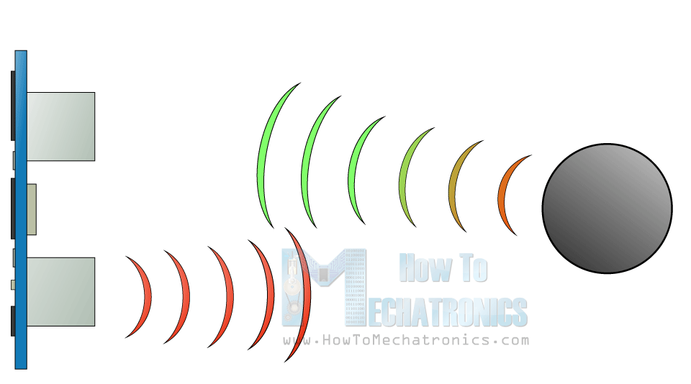
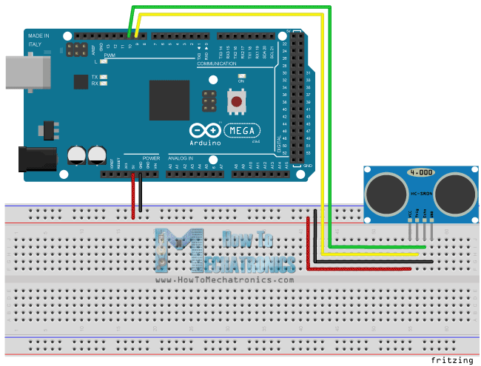
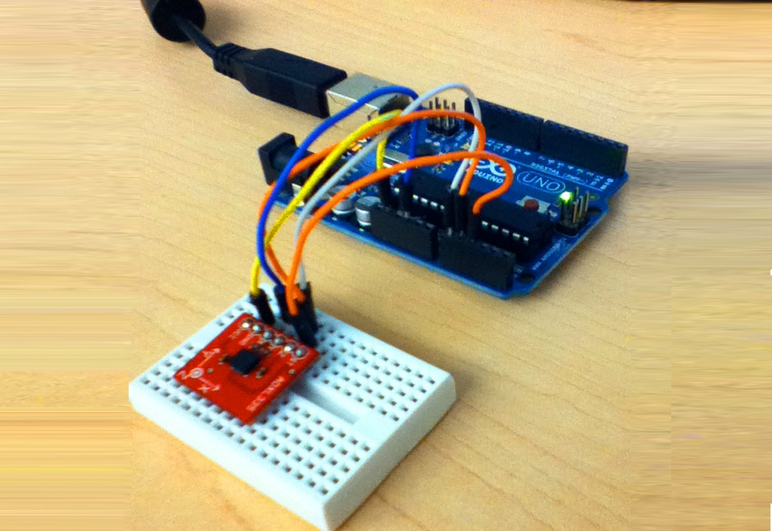

Slide 9
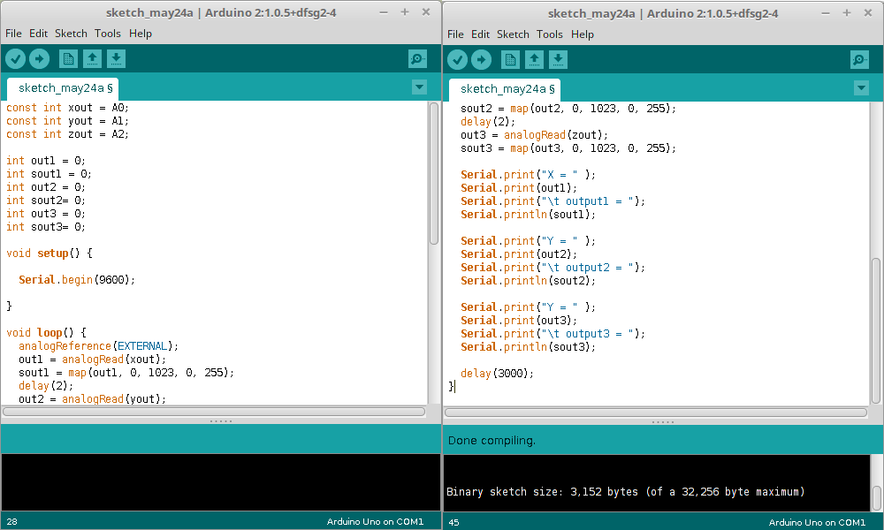
Diagram of ide examples

Slide 10
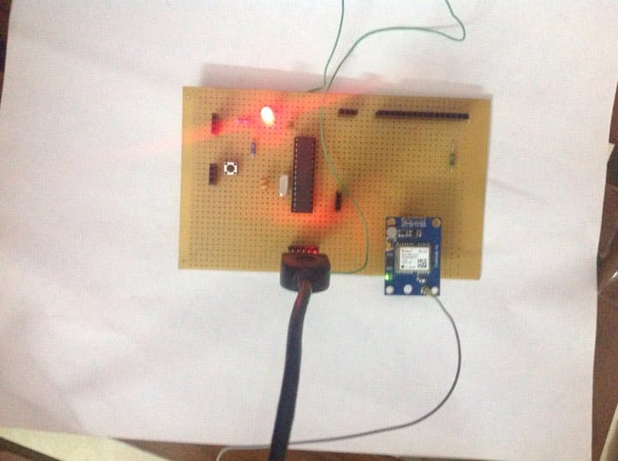
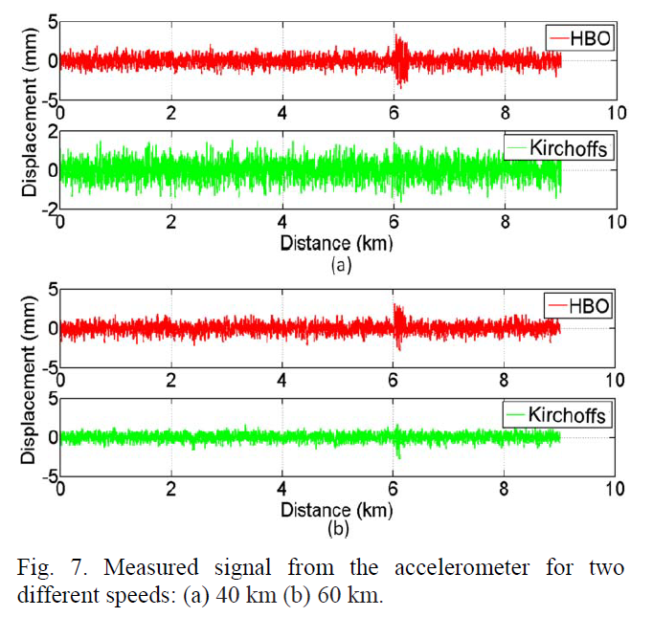
Accelerometer and others

Slide 11
Working of device

Slide 13
Working of device
The system comprises of an Accelerometer, GPS Receiver, Arduino Board, a server and a custom made mapping application.
The accelerometer will produce values of X, Y, Z axes (coordinates).
The GPS receiver provides the latitude and longitude coordinates.
The Arduino Board is used as a communicating interface between the GPS and the accelerometer and a server which is used to receive the data and send it to the server for classification and storage.
The server, on receiving the coordinates of the irregularity, classifies them based on the severity and stores them in the database.

Slide 14
The mapping application, which is custom made, is designed to accept the source and the destination and shows the presence of any irregularities on the path.

Slide 15
Implementation
The system consists of a device that is designed by integrating an accelerometer, GPS with help of an Arduino Board.
The accelerometer can be utilized to detect dynamic force like vibrations due to its high sensitivity to a very small change too.
This method is not only feasible but flexible i.e. can be used in any environment (on any vehicle) just by changing the sensitivity of the device.
The overall system is cost effective and highly reliable in terms of accuracy.
It forms an intelligent system which operates without any human intervention and reduces reliance on manual methods for maintenance of record and detection.

Slide 16
Accelerometer in conjunction with GPS module is an innovative approach to design an efficient system to map all the damaged roads all across the globe.
The coordinates, obtained when the vehicle encounters a pothole, is sent to the server that uses an algorithm to classify the pothole based on its severity and stores it in the database.
These coordinates are used to display the locations and the severity of the potholes on the mapping application.

Slide 17
Test cases
To test in a dry condition
To test in a vehicle
To calculate the distance between vehicle and pothole
To identify the location on map

Slide 18
ADVANTAGES
Reducing the time invested by personnel in monitoring damaged roads.
Can be implemented in any vehicle without causing any change in the mechanism of the vehicle.
It can function effectively and efficiently in any weather condition.

Slide 19
Future scope
Reduce accidents
Provides Information to PWD so that they can know in advance and repair the pothole on time.
It can helps to know in advance which road or path to use.
The sensors will be attached to vehicles and from vehicles the data’s obtained from sensors and the location obtained by the GPS are transferred to road transport authority by IOT .
Using the data’s obtained more damaged area can be prioritized and damage control can be reduced.

Slide 20
References
#1. Pothole Detection: An Efficient Vision Based Method Using RGB Color Space Image Segmentation Conference Paper · May 2017 with 3,032 Reads DOI: 10.23919/MIPRO.2017.7973589 Conference: The 40th International Convention on Information and Communication Technology, Electronics and Microeletronics, Opatija, Croatia
#2. A Real-Time Pothole Detection Approach for Intelligent Transportation System Institute of Information Management, ²Telecommunication Laboratories, ³Department of Information Management
#3.Convolutional neural networks based potholes detection using thermal imaging Journal of King Saud University - Computer and Information Sciences
#4. ANAUTOMATIC ROAD DISTRESS VISUAL INSPECTION SYSTEM USING AN ONBOARD IN-CAR CAMERA (Thitirat Sirborvornratanakul Graduate School os Applied Statistics, National Institute of Development Administration (NIDA) , 118 Seri Thai Rd. Bangkapi ,Bangkok , Thailand)
#5. Image Based Pothole Detection System for ITS Service and Road Management System (Seung-Ki Ryu,1 Taehyeong Kim,1 and Young-Ro Kim2 1Highway and Transportation Research Institute, Korea Institute of Civil Engineering and Building Technology, 283 Goyangdae-ro , Ilsanseo-gu,goyang-si 411-712, Republic of Korea 2Department of Computer Science and Information, Myongji College, Seoul 120-848,Republic of Korea)

Slide 21
CONCLUSION
This will be an important tool to avoid accidents in the place where the risk of accident or injury is substantial.
Irregularities are more dangerous in low visibility conditions, such as night time, or foggy conditions, rain or snow.
It also provides a novel method to have a reliable database about the road conditions and accident prone areas and can be further used to upgrade infrastructure.
The project can be extended to enhance the suspension systems of low cost vehicles and increase the comfort of the driver.

